Slide 1
Lecture # 17-18
Dr. M. Nadeem

Slide 2
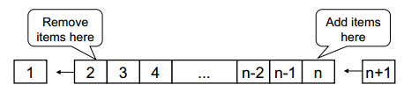
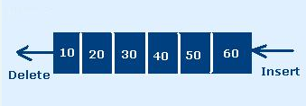
What is Queue?
Queue is a linear Data Structure in which insertion operation is performed at one end called Rear and deletion operation is performed at another end called front.

Slide 3
Queue
Queue is ordered collection of homogeneous data elements in which insertion and deletion operation take place at two end . insertion allowed from starting of queue called REAR point and deletion allowed from FRONT end only
insertion operation is called ENQUEUE
deletion operation is called DEQUEUE
Notes:
Queue Ordered collection of items in a linear way

Slide 4
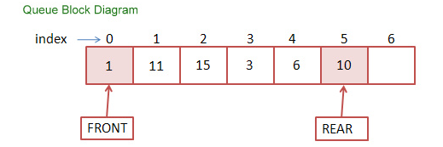
Block Diagram of Queue

Slide 5
Basic features of Queue
Like Stack, Queue is also an ordered list of elements of similar data types.
Queue is a FIFO( First in First Out ) structure.
Once a new element is inserted into the Queue, all the elements inserted before the new element in the queue must be removed, to remove the new element.
peek( ) function is oftenly used to return the value of first element without dequeuing it.

Slide 6
Applications of Queue
Queue, as the name suggests is used whenever we need to have any group of objects in an order in which the first one coming in, also gets out first while the others wait for there turn, like in the following scenarios :
Real life examples
Waiting in line
Waiting on hold for tech support
Serving requests on a single shared resource, like a printer, CPU task scheduling etc.

Slide 7
Applications of Queue
In real life, Call Center phone systems will use Queues, to hold people calling them in an order, until a service representative is free.
Applications related to Computer Science
Threads
Job scheduling (e.g. Round-Robin algorithm for CPU allocation)
Handling of interrupts in real-time systems. The interrupts are handled in the same order as they arrive, First come first served.

Slide 8
Applications of Queue
Operating system
multi-user/multitasking environments, where several users or task may be requesting the same resource simultaneously.
Communication Software
queues to hold information received over networks and dial up connections. (Information can be transmitted faster than it can be processed, so is placed in a queue waiting to be processed)

Slide 9
Applications of Queue
Consider a Queue of Students at Fee Counter waiting to pay fee. The students pay fee in the same order as they are standing in the queue. The students who stand first in the Queue pay the fees first and come out from the queue.

Slide 10
Implementation
Static
Queue is implemented by an array, and size of queue remains fix
Dynamic
A queue can be implemented as a linked list, and expand or shrink with each enqueue or dequeue operation.

Slide 11
Common Operations on Queue
Queue(): creates a new queue that is empty. It needs no parameters and returns an empty queue.
MAKENULL(Q): Makes Queue Q be an empty list.
FRONT(Q): Returns the first element on Queue Q.
ENQUEUE(x,Q): Inserts element x at the end of Queue Q.
DEQUEUE(Q): Deletes the first element of Q.
EMPTY(Q): Returns true if and only if Q is an empty queue.
SIZE(): Returns the number of items in the queue. It needs no parameters and returns an integer.

Slide 12
Front and rear
Front
Rear

Slide 13
Conditions in Queue
FRONT < 0 ( Queue is Empty )
REAR = Size of Queue ( Queue is Full )
FRONT < REAR ( Queue contains at least one element )
No of elements in queue is : ( REAR - FRONT ) + 1

Slide 14
3 states of the queue
1.Queue is empty
FRONT=REAR
2.Queue is full
REAR=N
3.Queue contains element >=1
FRONT<REAR
NO. OF ELEMENT = REAR-FRONT+1

Slide 15
peek()
This function helps to see the data at the front of the queue. The algorithm of peek() function is as follows −
Algorithm
begin procedure peek
return queue[front]
end procedure

Slide 16
isfull() Algorithm
begin procedure isfull
if rear equals to MAXSIZE
return true
else
return false
endif
end procedure

Slide 17
isempty() Algorithm
begin procedure isempty
If front is less than MIN OR front is greater than rear
return true
else
return false
endif
end procedure

Slide 18
Restriction in Queue
we can not insert element directly at middle index (position) in Queue and vice verse for deletion.
Insertion operation possible at REAR end only and deletion operation at FRONT end, to insert we increment REAR and to delete we increment FRONT.

Slide 19
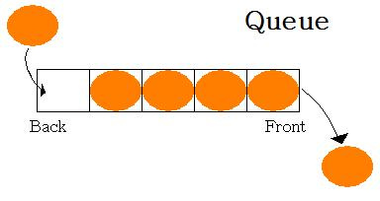
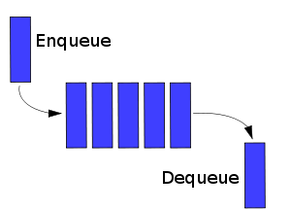
Enqueue and Dequeue

Slide 20
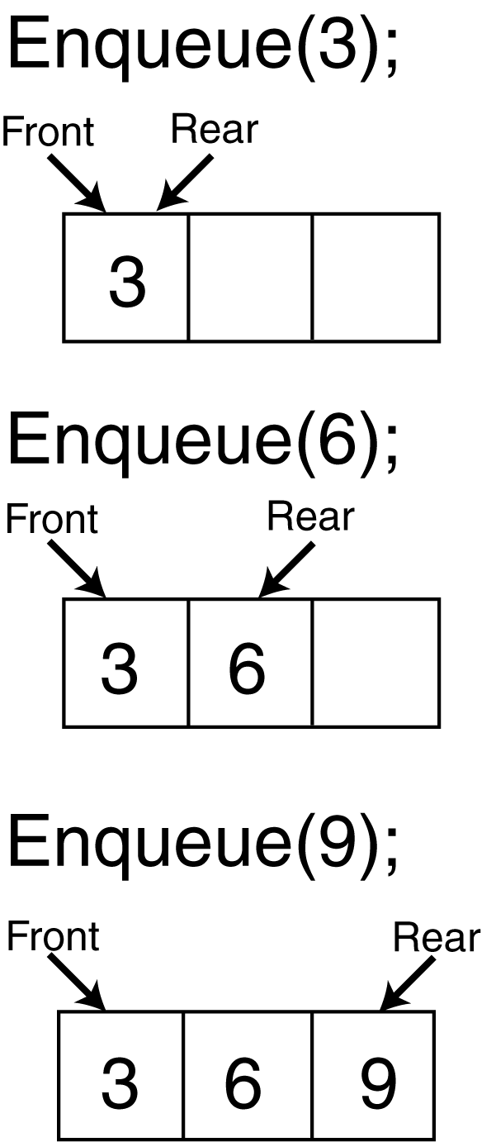
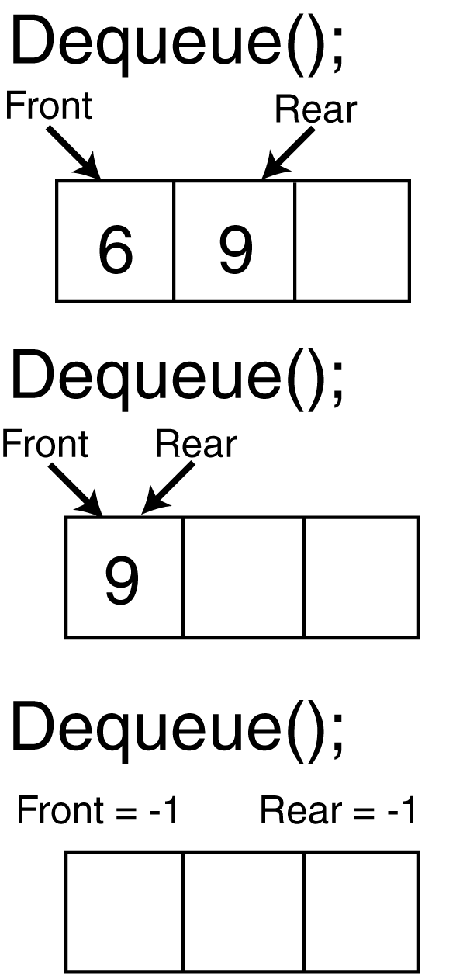
Enqueue and Dequeue

Slide 21
Enqueue Operation
Step 1 − Check if the queue is full.
Step 2 − If the queue is full, produce overflow error and exit.
Step 3 − If the queue is not full, increment rear pointer to point the next empty space.
Step 4 − Add data element to the queue location, where the rear is pointing.
Step 5 − return success.

Slide 22
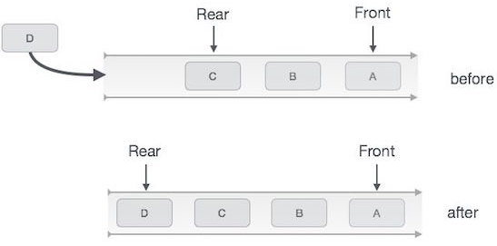
Enqueue Operation

Slide 23
Enqueue Operation
Insert Operation
In order to insert an element into Queue first we have to check weather space is available in the Queue or not.
If Queue is full then we can not insert an element into Queue. If value of REAR variable is greater then or equal to SIZE – 1 then we can not insert an element into Queue. This condition is known as “Overflow”.
If Queue is not overflow then we can insert an element into Queue. First we have to increment the value of REAR variable by one and then insert an element into Queue.
If the element which is inserted in Queue is first element then we have to set the value of FRONT variable to 0

Slide 24
Algorithm for ENQUEUE (insert element in Queue)
Input : An element say ITEM that has to be inserted.
Output : ITEM is at the REAR of the Queue.
Data structure : Que is an array representation of queue structure with two pointer FRONT and REAR.

Slide 25
Algorithm for ENQUEUE (insert element in Queue)
ENQUEUE (QUEUE, REAR, FRONT, N, ITEM)
0. Start 1. If REAR = N then //Queue is full 2. Display "Queue is full, Cannot insert a value" 3. Return
4. Else 5. If FRONT = 0 && REAR = 0 then //Queue is empty 6. FRONT = 1 7. End if 8. REAR = REAR + 1 // increment REAR 9. QUEUE[ REAR ] = ITEM 10. End if 11. End

Slide 26
Dequeue Operation
Step 1 − Check if the queue is empty.
Step 2 − If the queue is empty, produce underflow error and exit.
Step 3 − If the queue is not empty, access the data where front is pointing.
Step 4 − Increment front pointer to point to the next available data element.
Step 5 − Return success.

Slide 27
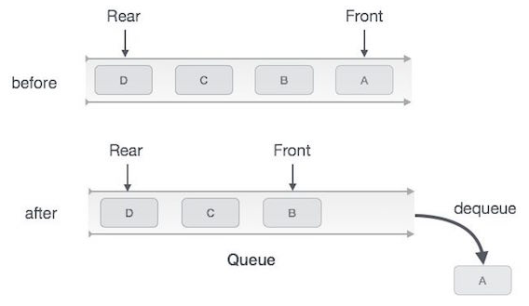
Dequeue Operation

Slide 28
Dequeue Operation
Delete Operation
In order to delete an element from Queue first we have to check weather Queue is empty or not.
If Queue is empty then we can not delete an element from Queue.
This condition is known as “Underflow”.
If Queue is not underflow then we can delete element from Queue.
After deleting element from Queue we have to set the value of FRONT and REAR variables according to the elements in the Queue.

Slide 29
Algorithm for DEQUEUE (delete element from Queue)
Input : A que with elements. FRONT and REAR are two pointer of queue .
Output : The deleted element is stored in ITEM.
Data structure : Que is an array representation of queue structure.

Slide 30
Algorithm for DEQUEUE (delete element from Queue)
DEQUEUE (QUEUE, REAR, FRONT, ITEM)
0. Start 1. If ( FRONT = 0 ) then 2. Display "Queue is empty, Cannot delete a value“
3. Return 4. Else 5. ITEM = QUEUE [ FRONT ] 6. If FRONT = REAR //only 1 element 7. REAR = 0 8. FRONT = 0 9. Else 10. FRONT = FRONT + 1 11. End if 12. End if 13. End

Slide 31
Array Implementation
A queue can be implemented with an array, as shown here. For example, this queue contains the integers 4 (at the front), 8 and 6 (at the rear).
[ 0 ]
[1]
[ 2 ]
[ 3 ]
[ 4 ]
[ 5 ]
. . .
4
8
6
An array of integers to implement a queue of integers
We don't care what's in
this part of the array.

Slide 32
Array Implementation
The efficient implementation also keeps track of the number of items in the queue and the index of the first element (at the front of the queue), the last element (at the rear).
3
size
0
first
2
last
[ 0 ]
[1]
[ 2 ]
[ 3 ]
[ 4 ]
[ 5 ]
. . .
4
8
6
Notes:
The easiest implementation also keeps track of three numbers. The size could be as small as zero or as large as the number of items in the array. The index of the front element is stored in the first member variable. The front item in the queue is at that index of the array. The next item is after the first one and so on until the rear of the queue that occurs at the index stored in a member variable called last.

Slide 33
Array Implementation
When an element leaves the queue, size is decremented, and first changes, too.
2
size
1
first
2
last
[ 0 ]
[1]
[ 2 ]
[ 3 ]
[ 4 ]
[ 5 ]
. . .
4
8
6
Notes:
This shows how the member variables change when an item leaves the queue.

Slide 34
An Enqueue Operation
When an element enters the queue, size is incremented, and last changes, too.
3
size
1
first
3
last
[ 0 ]
[1]
[ 2 ]
[ 3 ]
[ 4 ]
[ 5 ]
. . .
8
6
2
Notes:
And this shows how the member variables change when a new item enters the queue. For a fixed size array, a new item may enter only if the current size of the queue is less than the size of the array. For a dynamic array, we could increase the size of the array when the queue grows beyond the current array size.

Slide 35
Drawback of Linear Queue
Once the queue is full, even though few elements from the front are deleted and some occupied space is relieved, it is not possible to add anymore new elements, as the rear has already reached the Queue’s rear most position.
Circular Queue is designed to overcome the limitation of Simple Queue

Slide 36
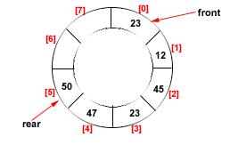
What is Circular Queue?
This queue is not linear but circular.
Its structure can be like the following figure:
In circular queue, once the Queue is full the "First" element of the Queue becomes the "Rear" most element, if and only if the "Front“ has moved forward. otherwise it will again be a "Queue overflow" state.
Figure: Circular Queue having Rear = 5 and Front = 0

Slide 37
Operations Performed on Circular Queue
Insert operation is used to insert an element into Circular Queue.
In order to insert an element into Circular Queue first we have to check weather space is available in the Circular Queue or not.
If Circular Queue is full then we can not insert an element into Circular Queue.
If value of REAR variable is greater then or equal to SIZE and value of FRONT variable is equal to 1 then we can not insert an element into Circular Queue.
This condition is known as “Overflow”.
If Queue is not overflow then we have to set the value of REAR variable and then we can insert an element into Circular Queue.

Slide 38
Algorithms for Insertion Operations in Circular Queue
Insert-Circular-Q(CQueue, Rear, Front, N, Item)
CQueue is a circular queue where to store data.
Rear represents the location in which the data element is to be inserted and Front represents the location from which the data element is to be removed.
Here N is the maximum size of CQueue and finally, Item is the new item to be added.
Initailly Rear = 0 and Front = 0.

Slide 39
Algorithms for Insertion Operations in Circular Queue
Insert-Circular-Q(CQueue, Rear, Front, N, Item)
1. If Front = 0 and Rear = 0 then Set Front := 1 and go to step 4.
2. If Front =1 and Rear = N or Front = Rear + 1 then
Display “Circular Queue Overflow”
Return.
Endif
3. If Rear = N then Set Rear := 1 and go to step 5.
4. Set Rear := Rear + 1
5. Set CQueue [Rear] := Item.
6. Return

Slide 40
Operations Performed on Circular Queue
In order to delete an element from Circular Queue first we have to check weather Circular Queue is empty or not.
If Circular Queue is empty then we can not delete an element from Circular Queue.
This condition is known as “Underflow”.
If Circular Queue is not underflow then we can delete an element from Circular Queue.
After deleting an element from Circular Queue we have to set the value of FRONT and REAR variables according to the elements in the Circular Queue

Slide 41
Algorithms for Deletion Operations in Circular Queue
Delete-Circular-Q(CQueue, Front, Rear, Item)
Here, CQueue is the place where data are stored. Rear represents the location in which the data element is to be inserted and Front represents the location from which the data element is to be removed. Front element is assigned to Item. Initially, Front = 1.

Slide 42
Algorithms for Deletion Operations in Circular Queue
Delete-Circular-Q(CQueue, Front, Rear, Item)
1. If Front = 0 then
Print: “Circular Queue Underflow”
Return.
Endif
2. Set Item := CQueue [Front]
3. If Front = N then // Last element so move Front to 1
Set Front = 1
Return.
Endif
4. If Front = Rear then //only 1 element
Set Front = 0 and Rear = 0
Return.
5. Set Front := Front + 1
6. Return.

Slide 43
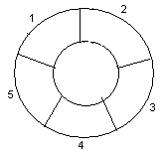
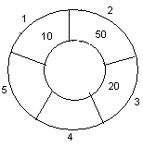
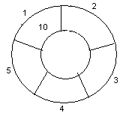
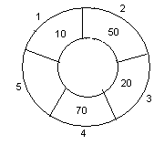
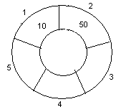
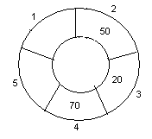
Example: Consider the following circular queue with N = 5.
1. Initially, Rear = 0, Front = 0.
4. Insert 20, Rear = 3, Front = 1.
Front
Rear
2. Insert 10, Rear = 1, Front = 1.
5. Insert 70, Rear = 4, Front = 1.
Rear
Front
Front
Rear
3. Insert 50, Rear = 2, Front = 1.
6. Delete front, Rear = 4, Front = 2.
Front
Rear
Front
Rear
43

Slide 44
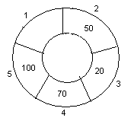
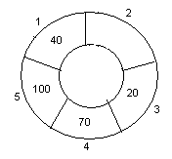
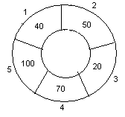
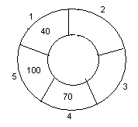
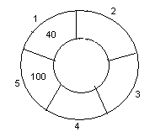
7. Insert 100, Rear = 5, Front = 2.
10. Delete front, Rear = 1, Front = 3.
Front
Rear
Front
Rear
8. Insert 40, Rear = 1, Front = 2.
11. Delete front, Rear = 1, Front = 4.
Rear
Rear
Front
Front
9. Insert 140, Rear = 1, Front = 2.
As Front = Rear + 1, so Queue overflow.
12. Delete front, Rear = 1, Front = 5.
Rear
Rear
Front
Front
44

Slide 45
Double-Ended Queue
A double-ended queue is an abstract data type similar to an simple queue, it allows you to insert and delete from both sides means items can be added or deleted from the front or rear end.

